Slide 1

Accident Prophet:
Predicting Road Incidents
REPORT!
Group 11
Mr. Nitesh Ghimire
Mr. Gholamreza Izadi
Mr. Tairo Kageyama
Mr. Panithi Sirisatjapipat
Mr. Bakyt Tursaliev

Slide 2
Table of contents
01
02
03
04
Introduction
Data Wrangling
Modeling
Deployment

Slide 3

01
Introduction
ACCIDENT!

Slide 4
Accident Prophet
Group 11
REPORT!
Introduction
Our product is driven by the belief that data-driven decision-making, coupled with the power of machine learning, can significantly enhance the way we understand and manage traffic accidents. "AccidentProphet" harnesses the potential of machine learning and data analytics to unlock valuable patterns and trends within accident records.

Slide 5
Accident Prophet
Accident information |  | Location |  | Road specification |  | Weather |  | Time
ID | object | Start_Lat | float64 | Amenity | bool | Airport_Code | object | Start_Time | object
Source | object | Start_Lng | float64 | Bump | bool | Weather_Timestamp | object | End_Time | object
Severity | int64 | End_Lat | float64 | Crossing | bool | Temperature(F) | float64 | Timezone | object
Distance(mi) | float64 | End_Lng | float64 | Give_Way | bool | Wind_Chill(F) | float64
Description | object | Street | object | Junction | bool | Humidity(%) | float64
 |  | City | object | No_Exit | bool | Pressure(in) | float64
 |  | County | object | Railway | bool | Visibility(mi) | float64
 |  | State | object | Roundabout | bool | Wind_Direction | object
 |  | Zipcode | object | Station | bool | Wind_Speed(mph) | float64
 |  | Country | object | Stop | bool | Precipitation(in) | float64
 |  |  |  | Traffic_Calming | bool | Weather_Condition | object
 |  |  |  | Traffic_Signal | bool | Sunrise_Sunset | object
 |  |  |  | Turning_Loop | bool | Civil_Twilight | object
 |  |  |  |  |  | Nautical_Twilight | object
 |  |  |  |  |  | Astronomical_Twilight | object
DATA

Slide 6
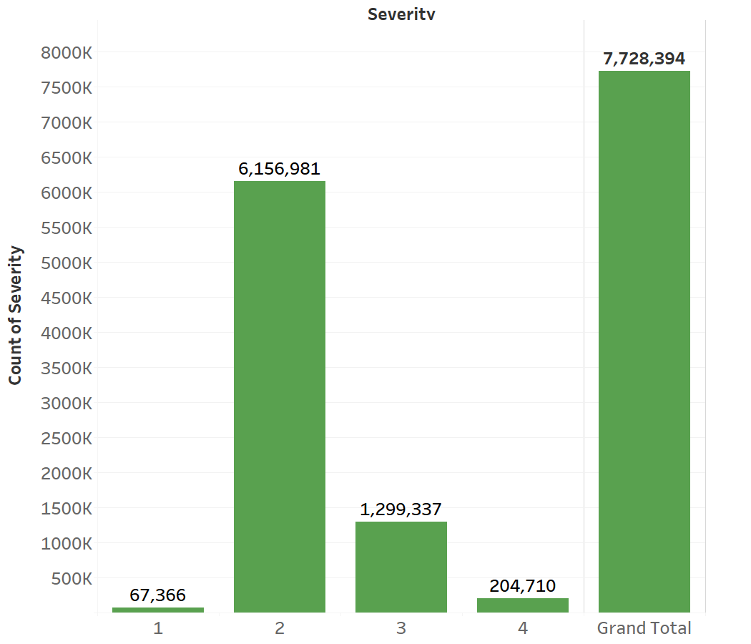
Accident Prophet
Group 11
DATA

Slide 7
02
Data Wrangling
ACCIDENT!

Slide 8
Accident Prophet
Group 11
Data Wrangling
Creating time component
Selecting records of year after 2020
Dropping End_Lat and End_Long
Removing samples with missing value
1 0
Creating Features “Delay(min)”
Converting Measurement to Metric Standard
Recode some variables such as weather condition and doing one hot encode for categorical columns
Recoding severity to two class attribute

Slide 9
Accident Prophet
Group 11
Data Wrangling
Creating count plots, bar plots, and scatter plot for different type of attributes
Describe data columns
Deleting 48 variables
Removing outliers
Creating dataframes X and Y
Train-test split
Imbalance fixing

Slide 10
03
Modeling
ACCIDENT!

Slide 11
Accident Prophet
Group 11
Modeling
Features and Label
 | Feature name | min | mean | max
1 | Start_Lat | 24 | 35 | 49
2 | Start_Lng | -124 | -93 | -67
3 | Humidity(%) | 1 | 64 | 100
4 | Crossing | 0 | 0 | 1
5 | Junction | 0 | 0 | 1
6 | Stop | 0 | 0 | 1
7 | Traffic_Signal | 0 | 0 | 1
8 | Sunrise_Sunset | 0 | 0 | 1
9 | Civil_Twilight | 0 | 0 | 1
10 | Start_Hour | 0 | 12 | 23
11 | IsWeekend | 0 | 0 | 1
12 | Temperature(C) | -29 | 16 | 44
13 | Pressure(cm) | 0 | 74 | 78
14 | Precipitation(cm) | 0 | 0 | 81
15 | Visibility(km) | 0 | 14 | 16
16 | Wind_Speed(kmph) | 0 | 12 | 88
17 | Weather_Bin_Clear | 0 | 0 | 1
18 | Weather_Bin_Cloudy | 0 | 0 | 1
19 | Weather_Bin_Rainy | 0 | 0 | 1
20 | Weather_Bin_Snowy | 0 | 0 | 1
21 | Start_Month_December | 0 | 0 | 1
22 | Start_Month_January | 0 | 0 | 1
Severity (0,1)

Slide 12
Accident Prophet
Group 11
Modeling
AdaBoost
XGBoost
AdaBoost
Mean Accuracy
0.6127
STD
0.001799
XGBoost
Mean Accuracy
0.6419
STD
0.001856
After data preparation, four classification algorithms (Adaboost, xgboost, Random Forest, Logistic Regression) were used. Cross-validation assessed their performance, helping select the best model based on accuracy, precision, recall, and F1-score..
RandomForest
Mean Accuracy
0.7299
STD
0.001901
Random Forest
Logistic
Mean Accuracy
0.5995
STD
0.001651
Logistic Regression

Slide 13
Accident Prophet
Group 11
Modeling
AdaBoost
XGBoost
AdaBoost
Mean Accuracy
0.6127
STD
0.001799
XGBoost
Mean Accuracy
0.6419
STD
0.001856
As it can be seen, the random forest classifier has the best performance among all classifiers. Hence, this model was selected for doing a grid search to find the best set of model parameters.
After data preparation, four classification algorithms (Adaboost, xgboost, Random Forest, Logistic Regression) were used. Cross-validation assessed their performance, helping select the best model based on accuracy, precision, recall, and F1-score..
RandomForest
Mean Accuracy
0.7299
STD
0.001901
Random Forest
Logistic
Mean Accuracy
0.5995
STD
0.001651
Logistic Regression

Slide 14
Accident Prophet
Group 11
Modeling
Cross Validation
Scores
mean
std
AdaBoost
[0.61 0.61 0.61 0.61 0.61]
0.6127
0.001799
XGBoost
[0.64 0.64 0.64 0.64 0.65]
0.6419
0.001856
Random Forest
[0.73 0.73 0.73 0.73 0.73]
0.7299
0.001901
Logistic Regression
[0.6 0.6 0.6 0.6 0.6 ]
0.5995
0.001651

Slide 15
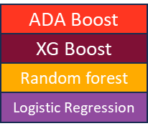
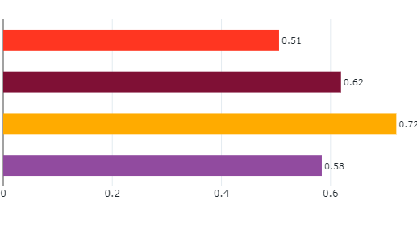
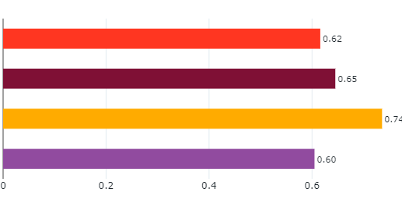
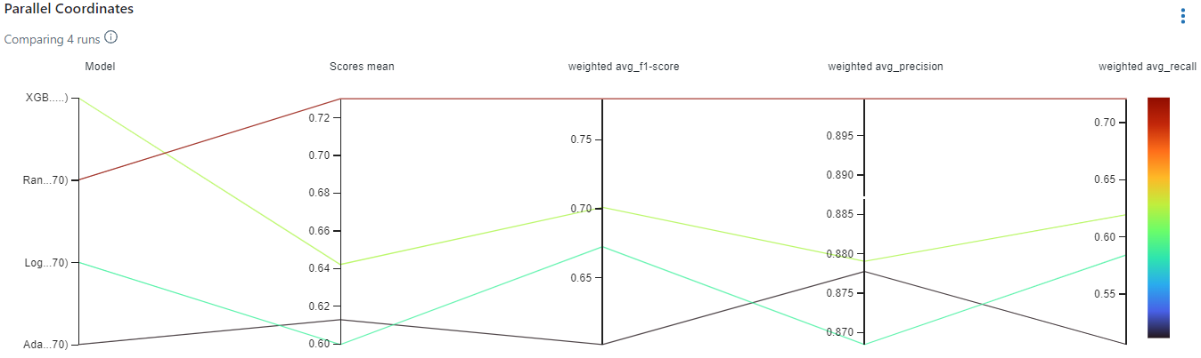
Accident Prophet
Group 11
Modeling
Cross Validation
Accuracy
ROC-AUC score

Slide 16
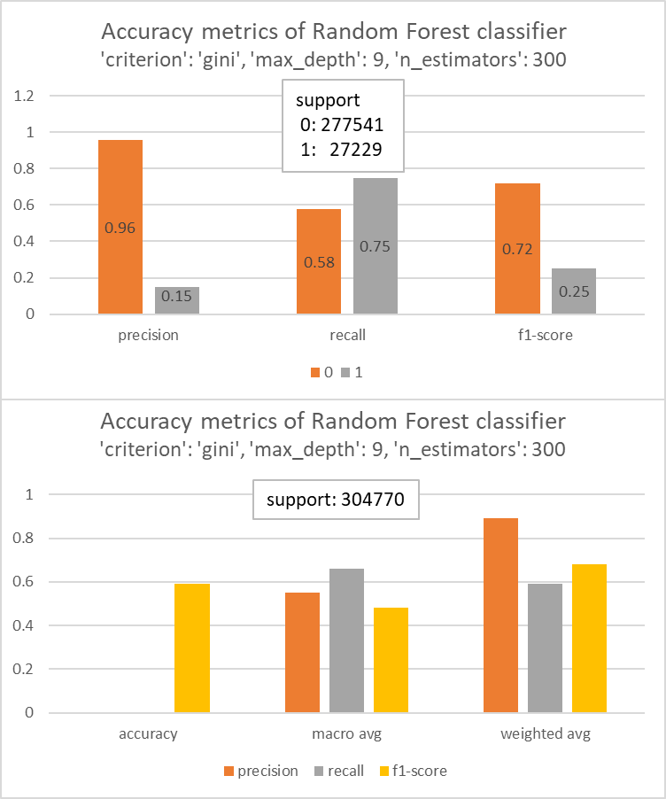
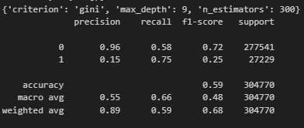
Accident Prophet
Group 11
Modeling
Evaluation
Modeling
Grid Search

Slide 17
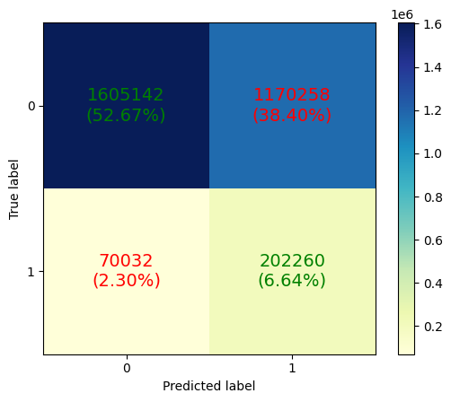
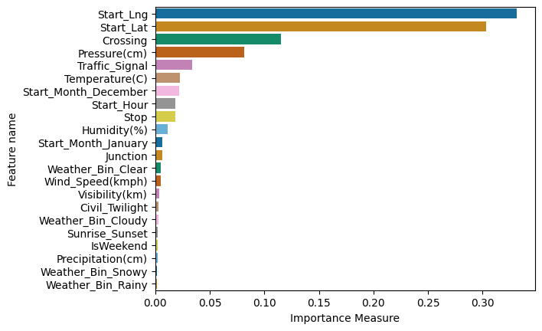
Accident Prophet
Group 11
Modeling
Feature Importance
Modeling
Inference

Slide 18
04
Deployment
ACCIDENT!

Slide 19
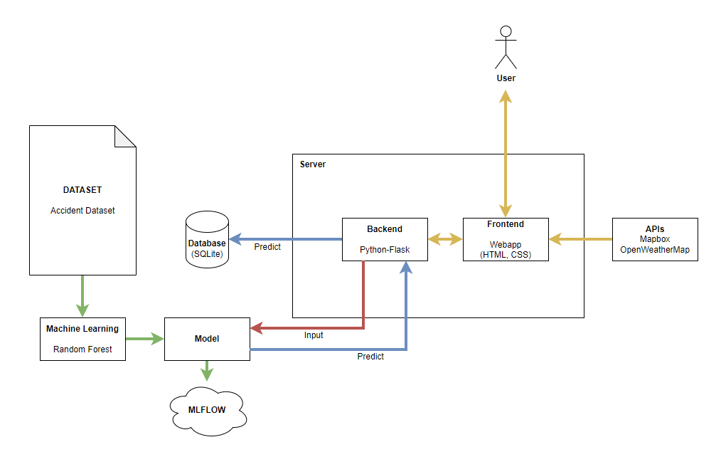
Accident Prophet
Group 11
Structure

Slide 20
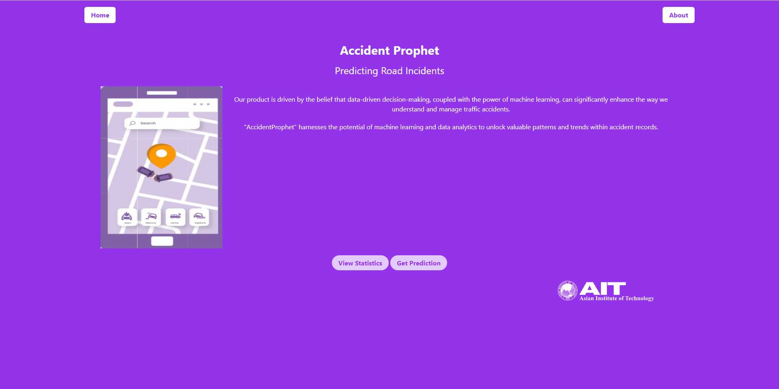
Accident Prophet
Group 11
Home

Slide 21
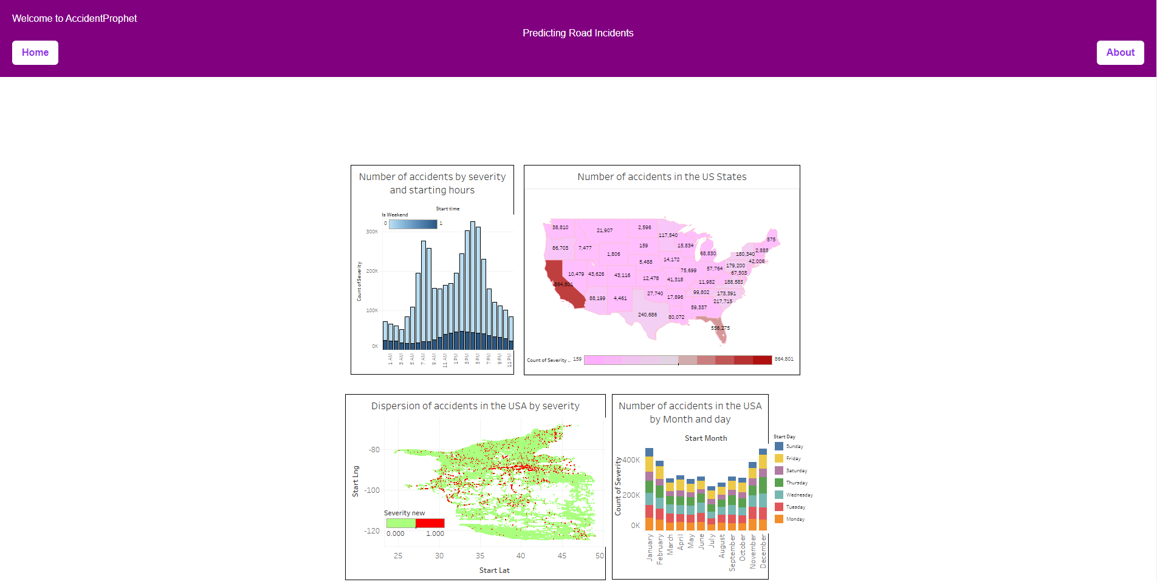
Accident Prophet
Group 11
View Statistics

Slide 22
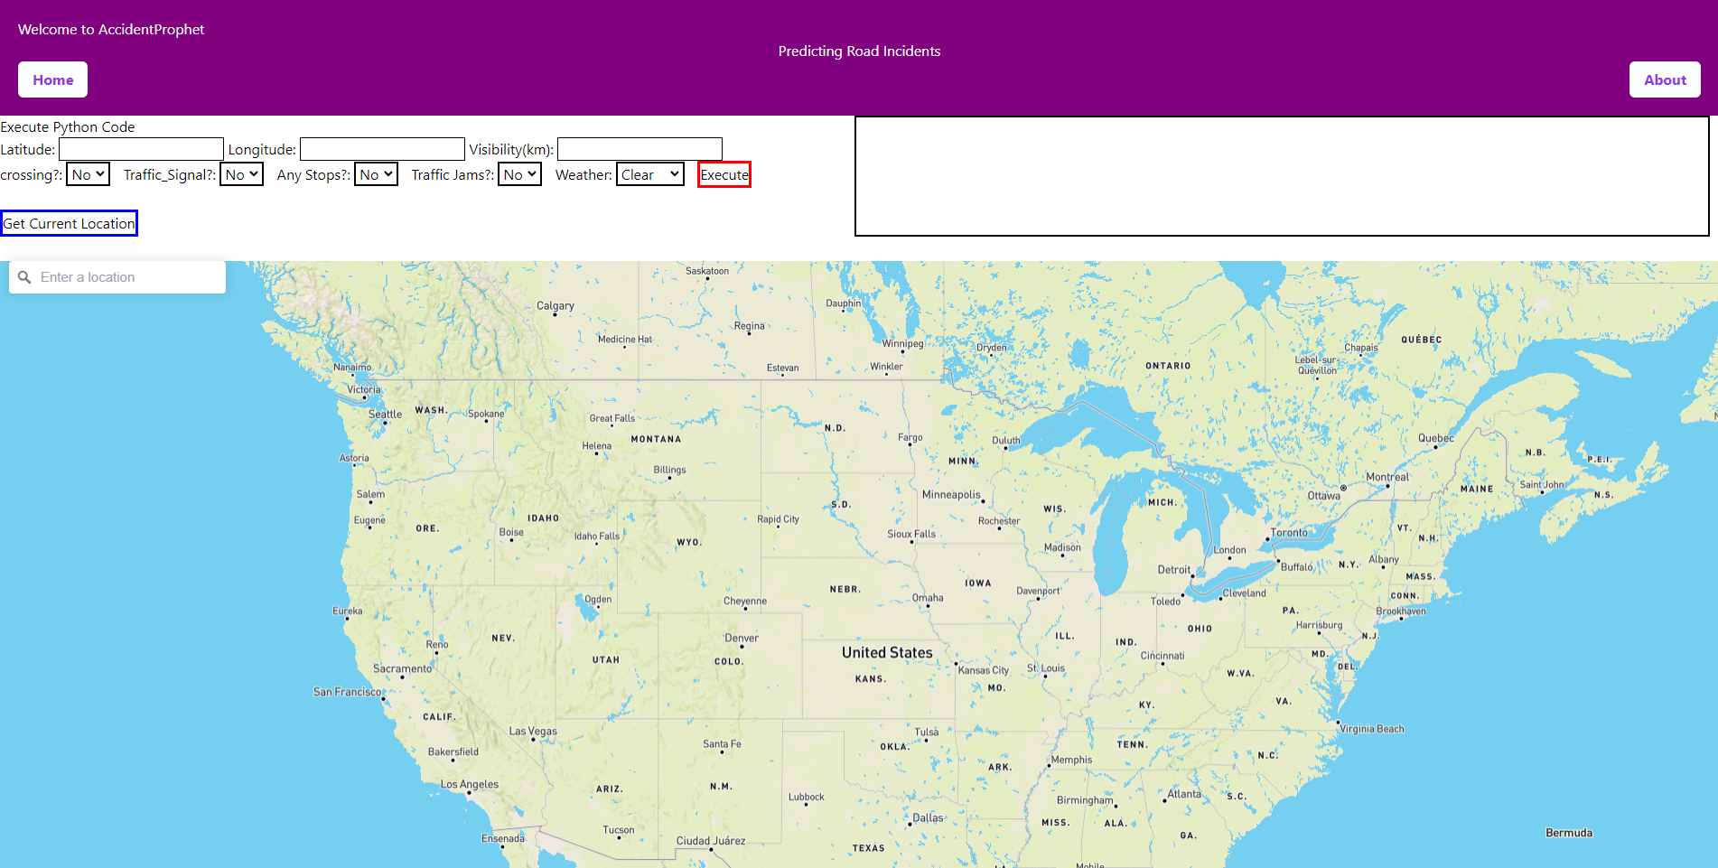
Accident Prophet
Group 11
Predict

Slide 23
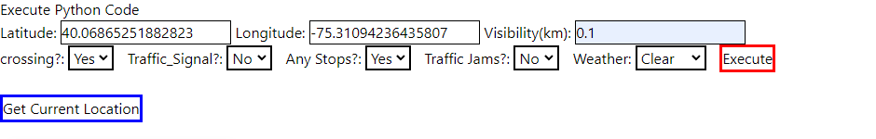
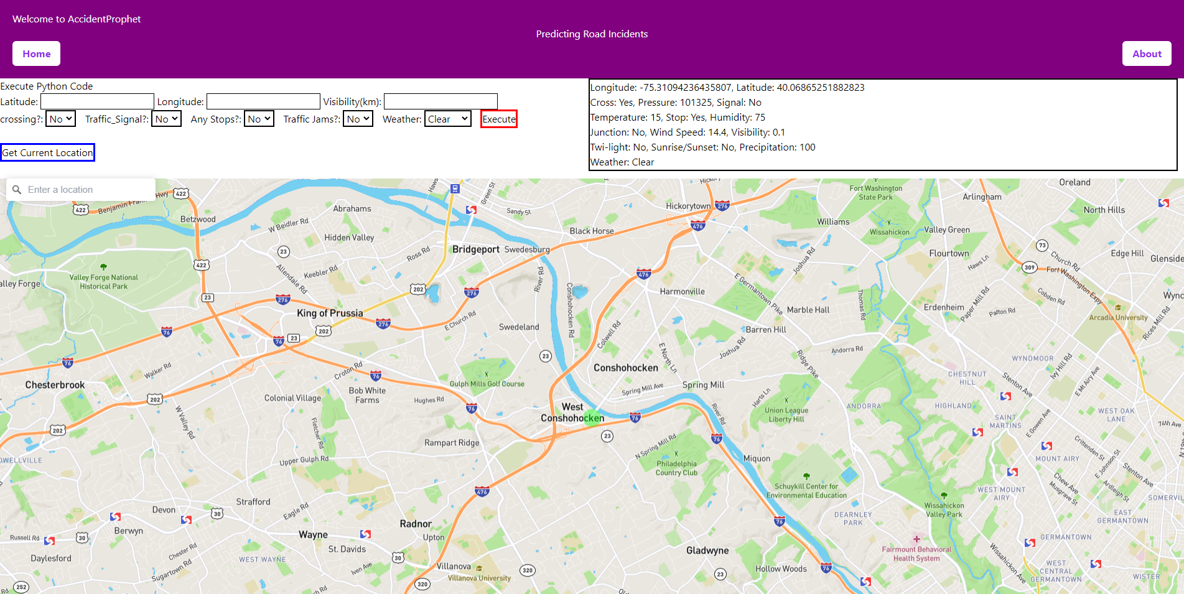
Accident Prophet
Group 11
Predict

Slide 24
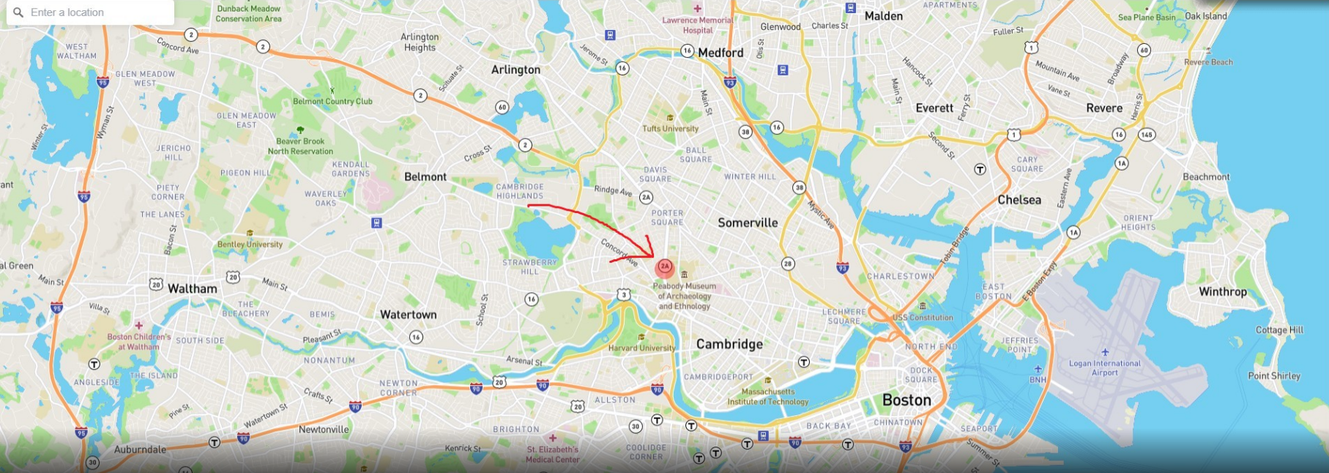
Accident Prophet
Group 11
Predict

Slide 25
Thank You So Much!

